Slide 1


Scheduling v1.0.0 Trial Implementation https://profiles.ihe.net/ITI/Scheduling/
IT Infrastructure (ITI) Domain
Steven Nichols, Planning Co-Chair

Slide 2

What is the Scheduling Profile?
A vendor agnostic specification providing FHIR APIs and guidance for access to, and booking of, appointments.
Designed for patient and practitioner end-users, improving ease of access and usability.
Facilitates communication of appointment information between mobile clients and healthcare systems using FHIR standards.
Leverages Argonaut 2017 Scheduling project
Base standards
FHIR 4.0.1
Appointment resource, $find, $hold, and $book operations

Slide 3
Actors
Scheduling Client: Requests scheduling operations (e.g., creating appointments).
May be grouped with PDQm Patient Demographics Consumer to identify the patient or patients for whom the appointment will be scheduled.
May be grouped with mCSD Care Services Selective Consumer to discover care services such as facilities and providers.
Scheduling Server: Stores and manages scheduling resources (e.g., slots, appointments).
Security and Privacy: Group with ATNA, IUA, BALP, PCF

Slide 4
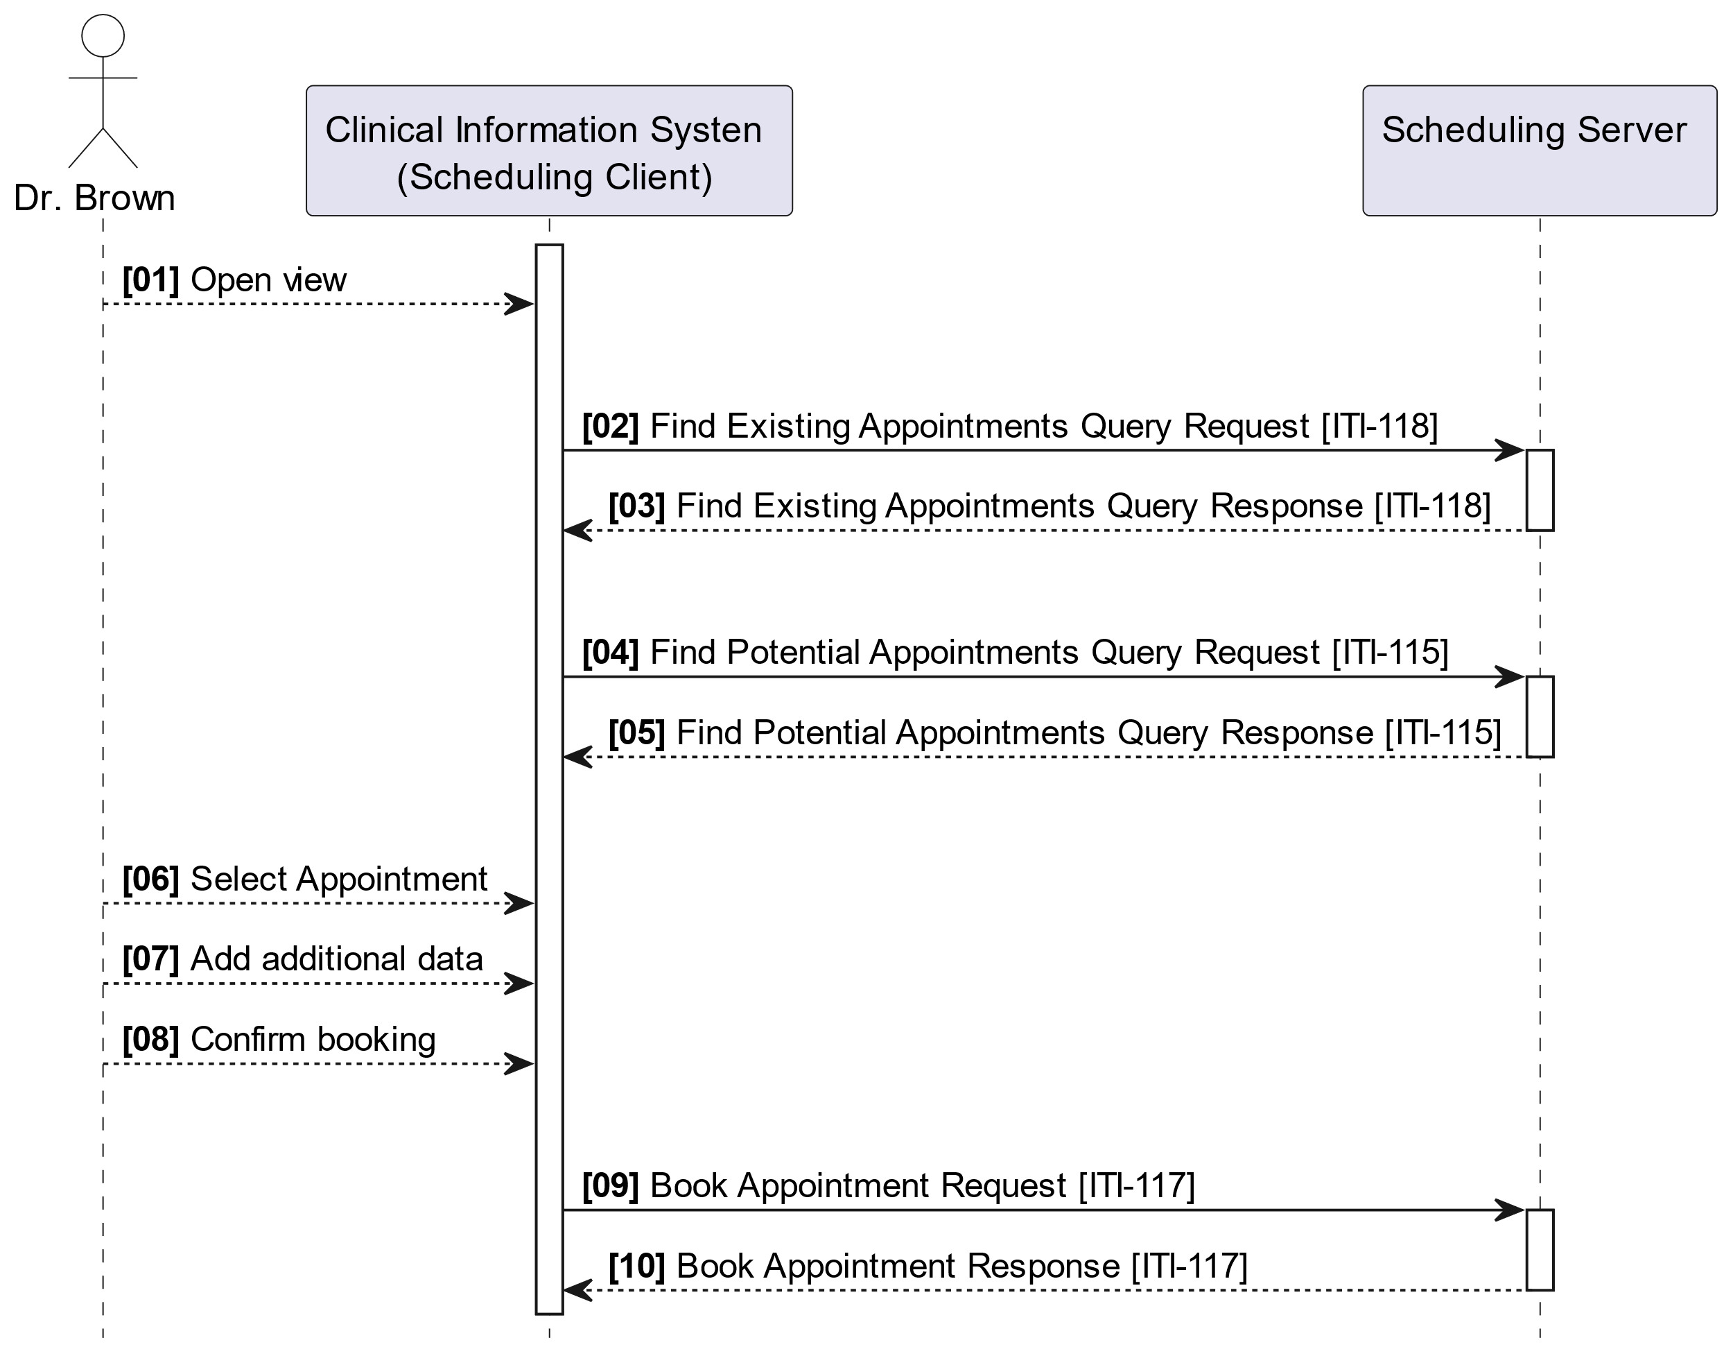
Use Case: Provider Schedules a Procedure from an EMR Client
Provider identifies the need for a radiology exam for her patient and uses her clinical information system to select a radiology facility and view available appointment slots.
After choosing a suitable time, she records the booking details and confirms the appointment within the system.

Slide 5
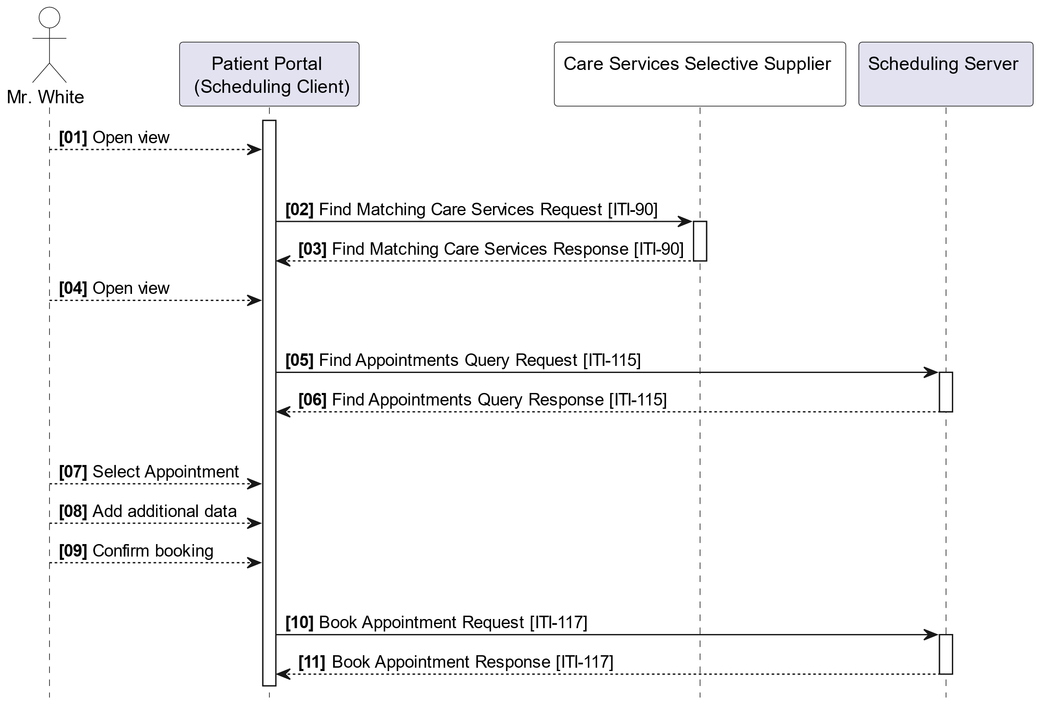
Use Case: Patient Schedules a Procedure from a Mobile Device
Patient feels unwell and uses a local patient portal to search for a healthcare provider based on criteria like location and opening hours.
After selecting a nearby practice, he chooses an available time slot, enters his booking details, and confirms the appointment through the portal.

Slide 6
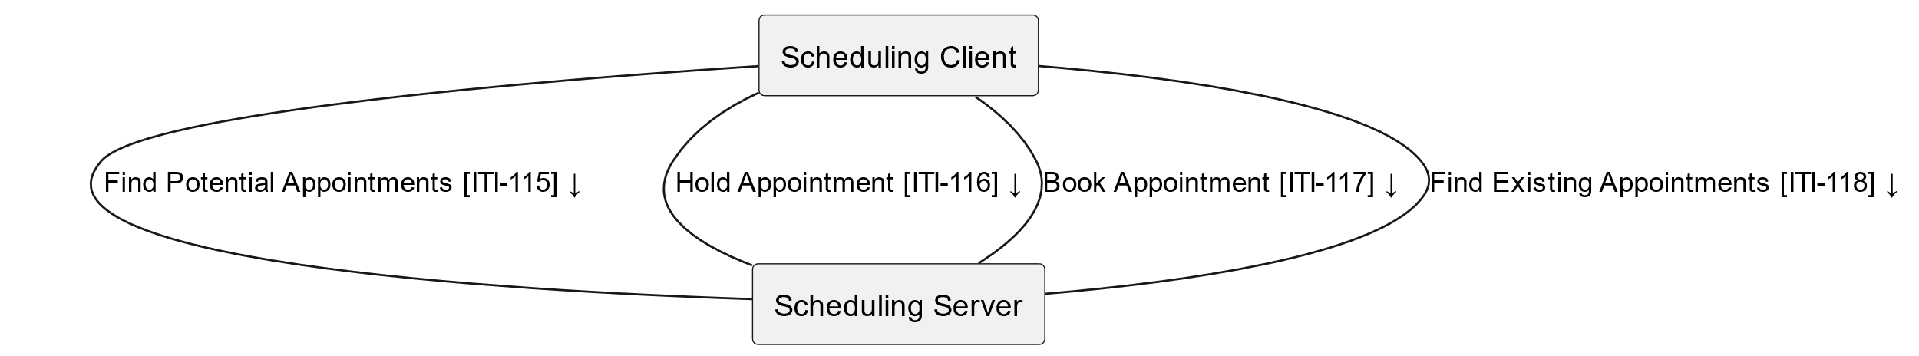
Transactions
Transactions:
Find Potential Appointments [ITI-115]
Hold Appointment [ITI-116]
Book Appointment [ITI-177]
Find Existing Appointments [ITI-118]

Slide 7
Benefits
Interoperability: Standardized API enables integration across systems.
Efficiency: Simplifies scheduling processes for patients and providers.
Scalability: Supports mobile applications for remote or distributed healthcare services.
Patient Experience: Improves accessibility and convenience.

Slide 8

IHE Scheduling Profile
Now in Trial Implementation
https://profiles.ihe.net/ITI/Scheduling
Feedback can be submitted at
https://www.ihe.net/ITI_Public_Comments/
https://github.com/IHE/ITI.Scheduling/issues

